Slide 1

DATA BASE MANAGEMENT SYSTEMS
PROJECT REVIEW
Group-10

Slide 2
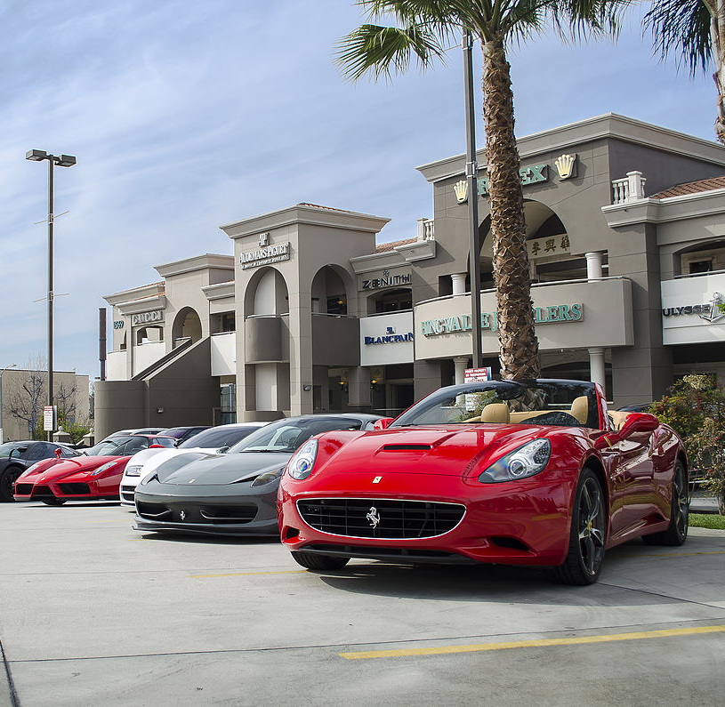
CAR RENTAL SYSYTEM

Slide 3

Team Members
1. CB.EN.U4CSE19453- ABHINAV
2. CB.EN.U4CSE19459 - SHANTHAN
3. CB.EN.U4CSE19405 - HEMANTH
4. CB.EN.U4CSE19449 - KOUSHIK

Slide 4
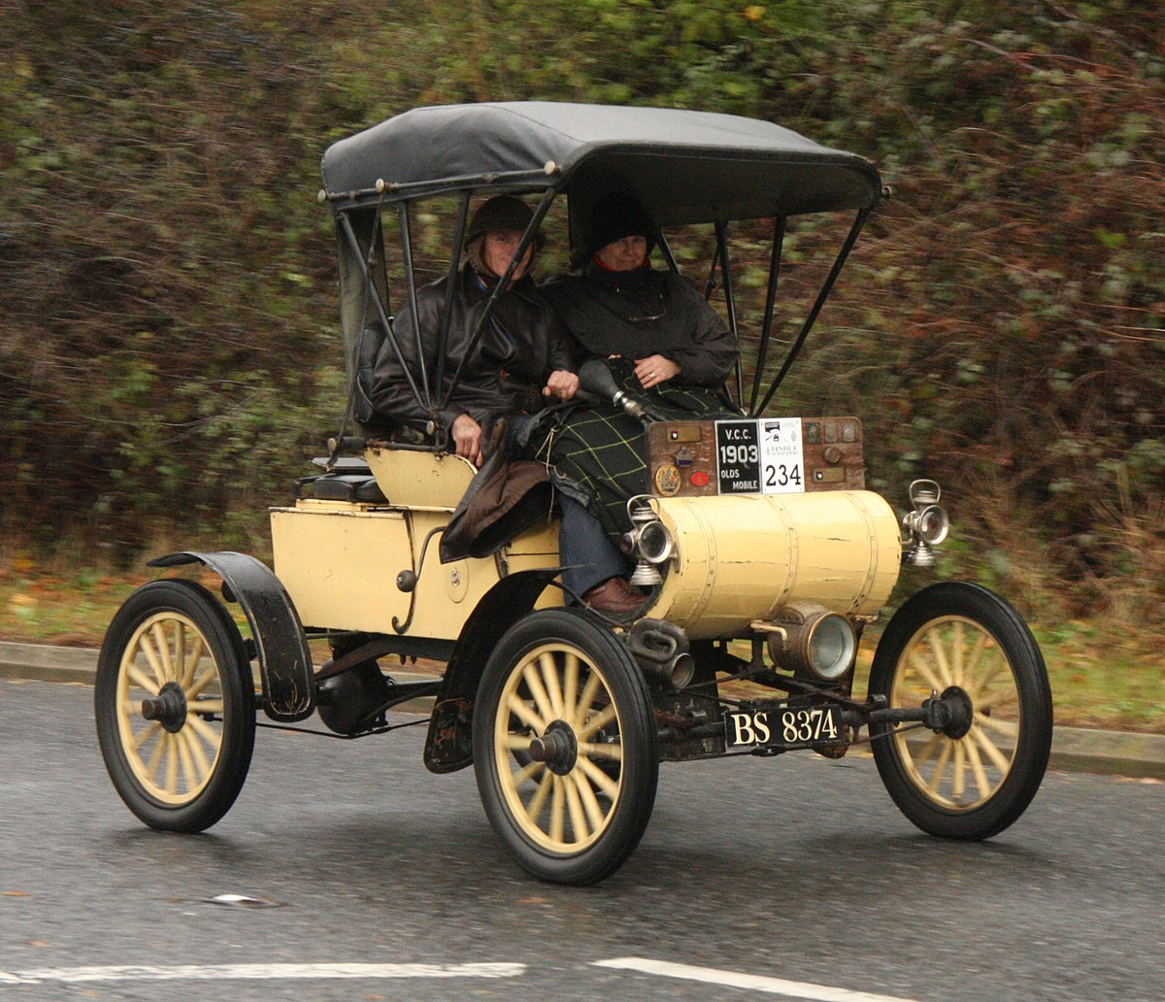

Description of Case Study:
Car rental system is an online system where customers can rent different kinds of cars of their interest. The main aim of this project is to design and develop a database for the car rental company to maintain the records of different types of information such as customer details, different cars details and it would be easy to keep track of different cars. This system simplifies the assignment of different cars and also increases the efficiency as it attracts many new customers.
This system makes the customers work to search for cars easy as all the details about the availability of different cars are available. This system also helps the car rental company to find the customers easily.

Slide 5

Extended ER

Slide 6
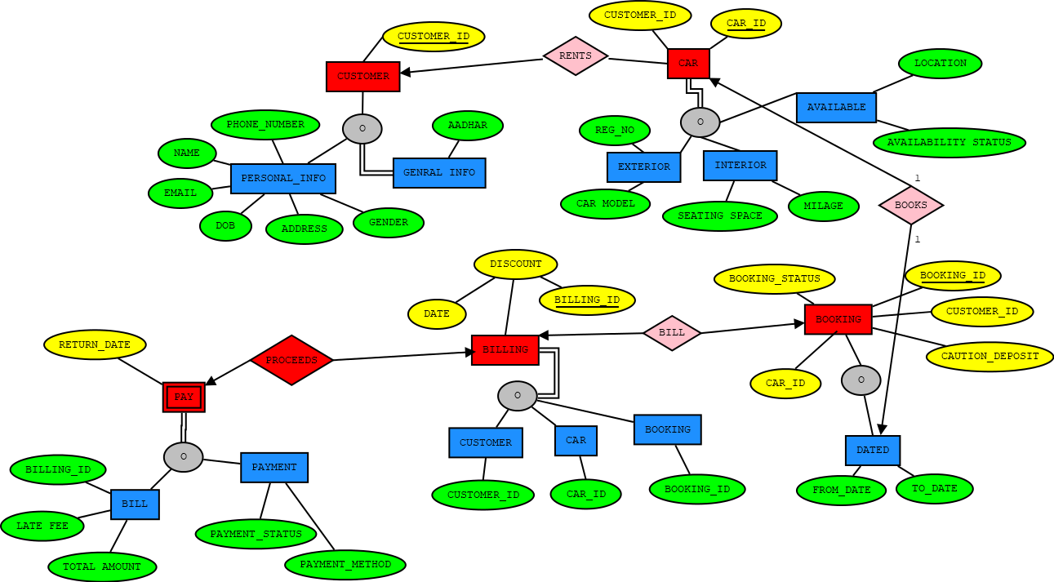

Slide 7
Normalization-1NF As per the rule of first normal form, an attribute (column) of a table cannot hold multiple values. should hold only atomic values.
1NF:
customer _id | customer _name | Phone No | Aadhaar | Email
Gender | DOB | Street | city | Zip code | car- id
car model | location | milage | Seating space | availability status
Reg. No | Booking _Id | caution deposit | booking status | From date | to-date
billing id | discount | date of billing | return - date | late fee | Total amount
payment method | Payment status

Slide 8
FUNCTIONAL DEPENDENCIES
(Customer_ID)-->customer_name, phone no , email, gender, DOB, Street, city, Zipcode, aadhar.
(Aadhar )-->customer_name, gender, DOB.
(Car_ID,Customer_id)-->Car Model, Location, Milage, Seating _space, Availability_Status,Reg_no
(Reg_no)-->Car Model, Milage, Seating Capacity.
(Booking_ID,Car_ID)--> Caution_deposit , booking status, from_date,to_date, Car_model
(Billing_Id, Booking _Id)--> discount, date of billing
( Billing)-->return _date, late _fee, Total amount, Payment status, payment method.
CANDIDATE KEY:
(CUSTOMER_ID,CAR_ID,BOOKING_ID,BILLING_ID)

Slide 9
Normalization-2NF In the second normal form, all non-key attributes are fully functional dependent on the primary key
Customer_ Id | Customer_ name | Phone _number | Email | Gender | Dob | Street | City | Zip_ code | Aadhar
Customer_ Id | Car_ Id | Car_ model | Location | Milage | Seating | Availability | Reg_ no
Car_ Id | Booking_ Id | Caution_ deposit | Booking_ Status | From_ date | To_ date | Car_ model
Booking_ Id | Billing_ Id | Discount | Date of billing
Billing_ Id | Return_ date | Late_ fee | Total_ amount | Payment_ status | Payment_ method

Slide 10
Normalization-3NF
A relation will be in 3NF if it is in 2NF and not contain any transitive partial dependency.
Customer_ Id | Phone_ number | Email | Street | City | Zip_ code | Car_ model | Aadhar
Aadhar | Customer_ name | Gender | Dob
Customer_ Id | Car_ Id | Car_ model | Location | Milage | Seating | Availability_ status | Reg_ no
Car_ Id | Booking_ Id | Car_ model | Caution_ deposit | Booking_ status | From_ date | To_ date
Booking_ Id | Billing_ Id | Discount | Date of billing
Billing_ Id | Return_ date | Late_ fee | Total_ amount | Payment_ status | Payment_ method

Slide 11
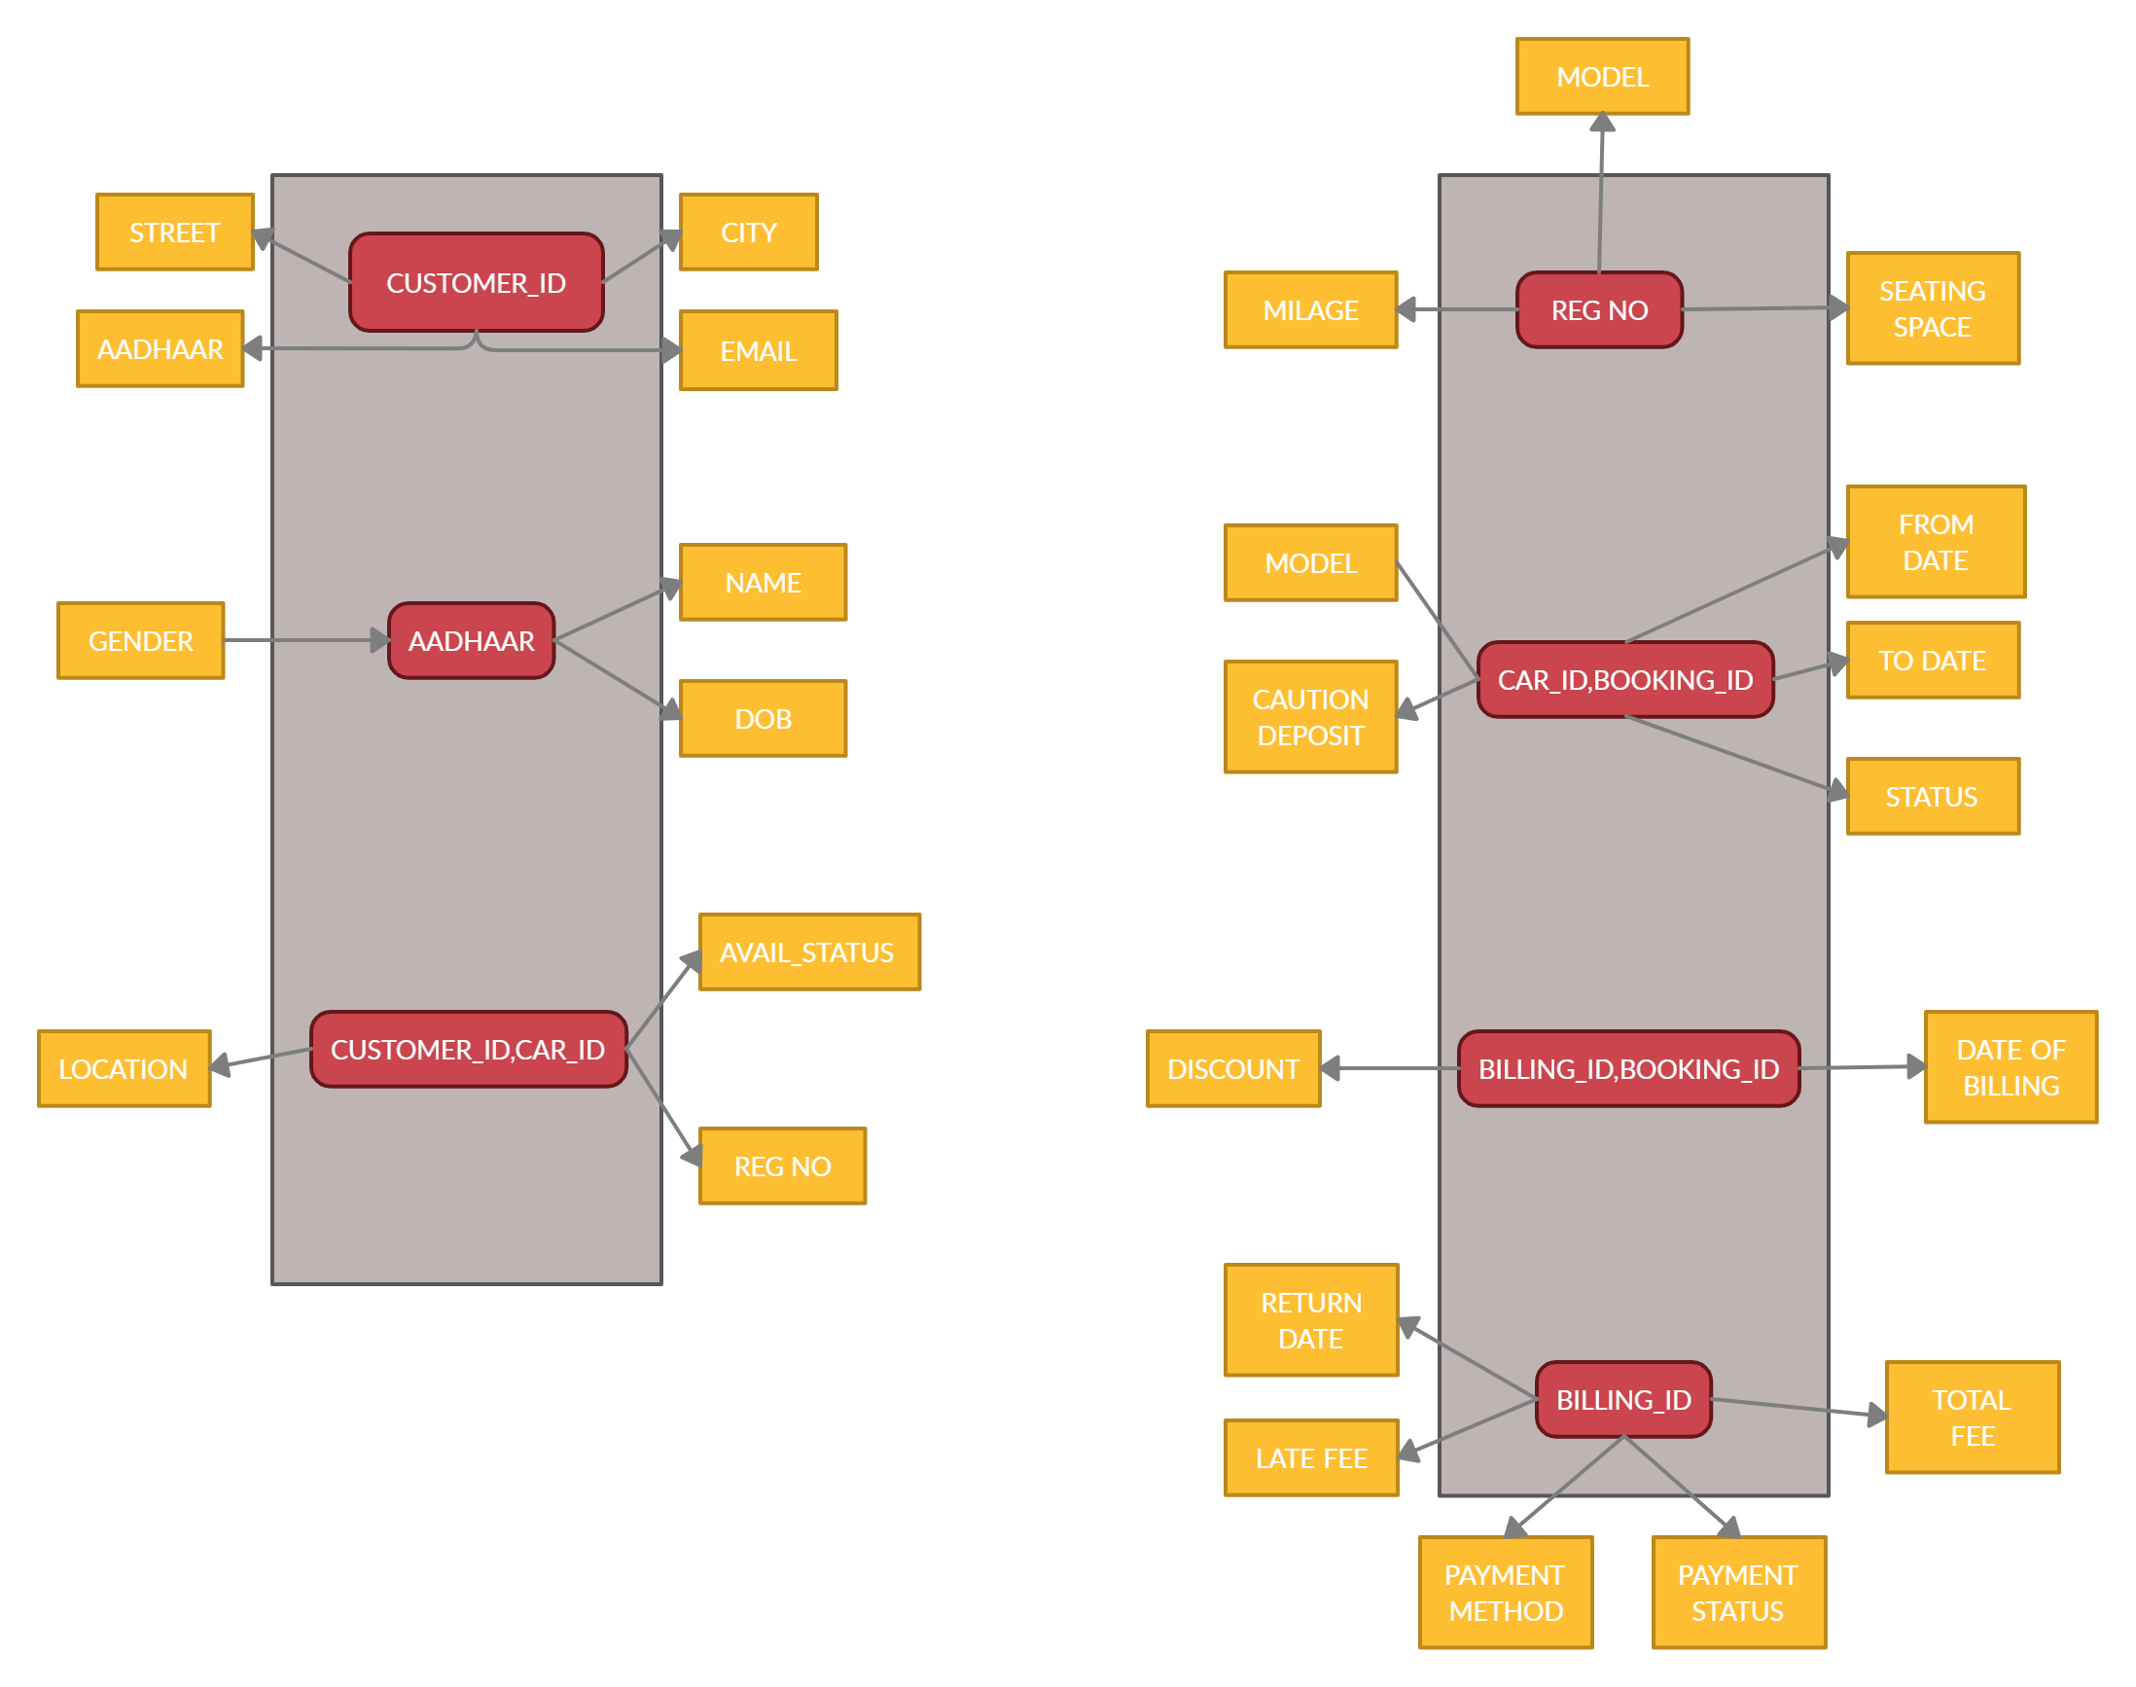
TABLES AFTER 3NF

Slide 12

THANK YOU

